Slide 1
Relational Algebra
Chpater 5
Notes:
1

Slide 2
Relational Query Languages
Query languages: Allow manipulation and retrieval of data from a database.
Relational model supports simple, powerful QLs:
  Strong formal foundation based on logic.
  Allows for much optimization.
Query Languages != programming languages!
  QLs not expected to be “Turing complete”.
  QLs not intended to be used for complex calculations.
  QLs support easy, efficient access to large data sets.
Notes:
2

Slide 3
Formal Relational Query Languages
Two mathematical Query Languages form the basis for “real” languages (e.g. SQL), and for implementation:
Relational Algebra: More operational, very useful for representing execution plans.
Relational Calculus: Lets users describe what they want, rather than how to compute it.

Slide 4
Preliminaries
A query is applied to relation instances, and the result of a query is also a relation instance.
  Schemas of input relations for a query are fixed (but query will run regardless of instance!)
  The schema for the result of a given query is also fixed! Determined by definition of query language constructs.
Notes:
4

Slide 5
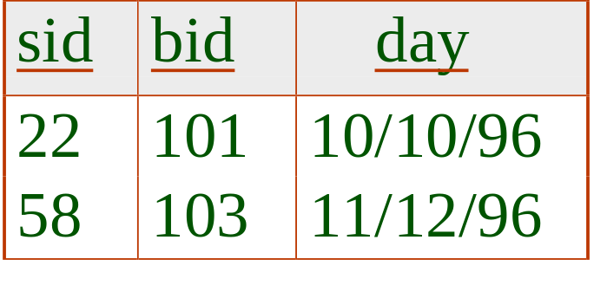
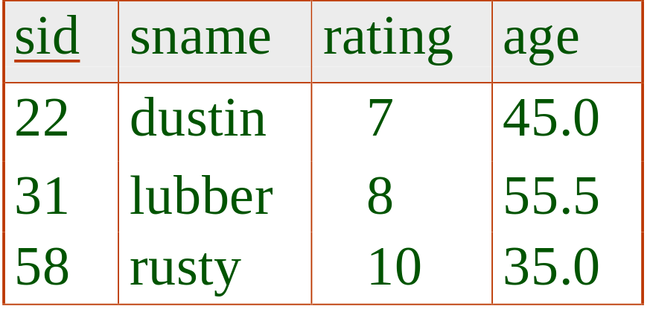
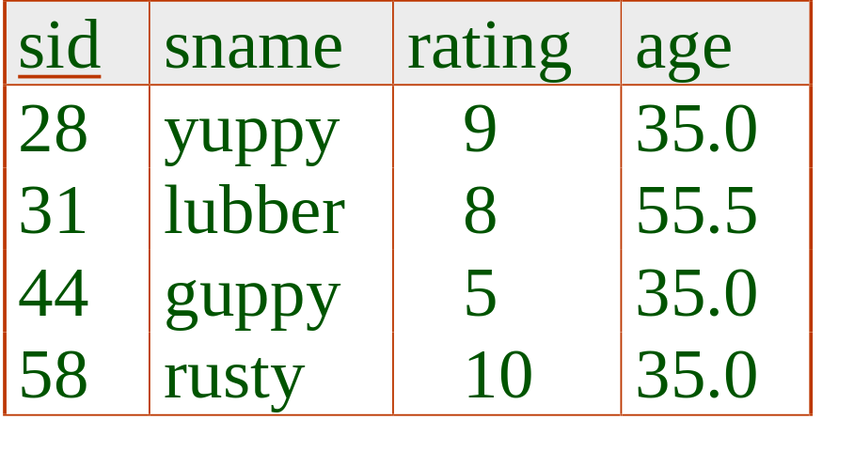
Example Instances
R1
“Sailors” and “Reserves” relations for our examples.
We’ll use positional or named field notation, assume that names of fields in query results are `inherited’ from names of fields in query input relations.
S1
S2
Notes:
5

Slide 6

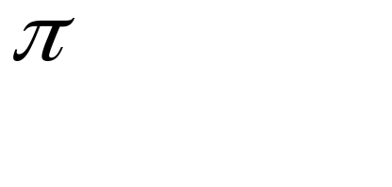



Relational Algebra
Basic operations:
  Selection ( ) Selects a subset of rows from relation.
  Projection ( ) Deletes unwanted columns from relation.
  Cross-product ( ) Allows us to combine two relations.
  Set-difference ( ) Tuples in reln. 1, but not in reln. 2.
  Union ( ) Tuples in reln. 1 and in reln. 2.
Additional operations:
  Intersection, join, division, renaming: Not essential, but (very!) useful.
Notes:
6

Slide 7
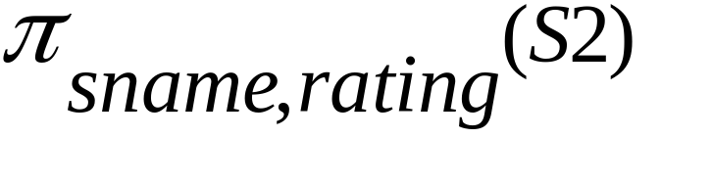
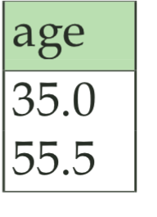
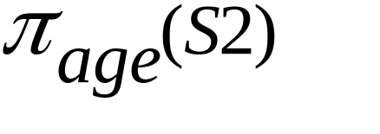
Projection
sname
rating
yuppy
9
lubber
8
Deletes attributes that are not in projection list.
Schema of result contains exactly the fields in the projection list, with the same names that they had in the (only) input relation.
Projection operator has to eliminate duplicates!
guppy
5
rusty
10
Notes:
7

Slide 8
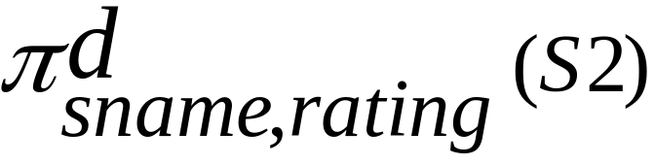
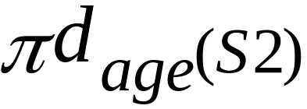
Duplicate Preserving Projection
age
35
55.5
35
35

Slide 9
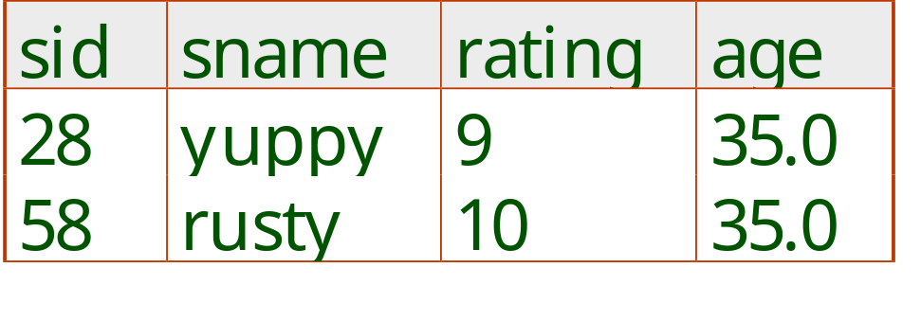
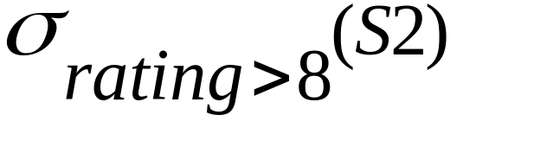
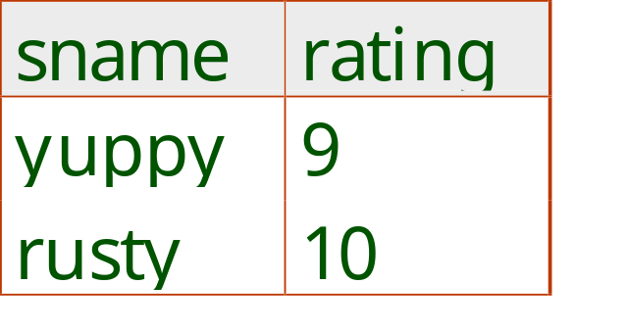
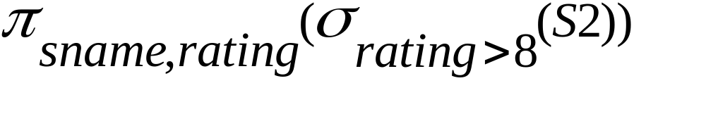
Selection
Selects rows that satisfy selection condition.
Schema of result identical to schema of input relation.
Result relation can be the input for another relational algebra operation! (Operator composition.)
Duplicates are preserved.
Notes:
8

Slide 10
Union, Intersection, Set-Difference
AUB
A-B
AnB
B-A
A
B

Slide 11
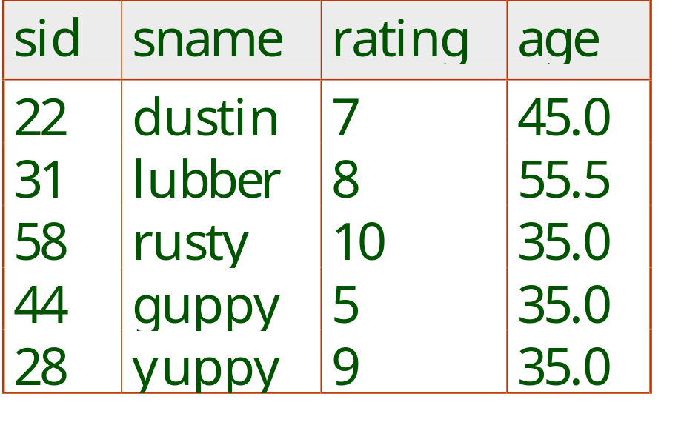

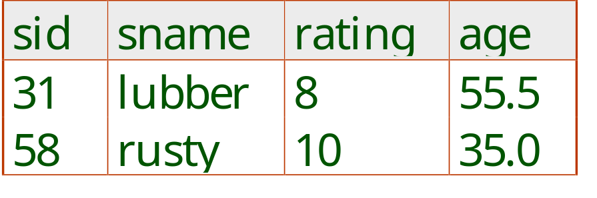
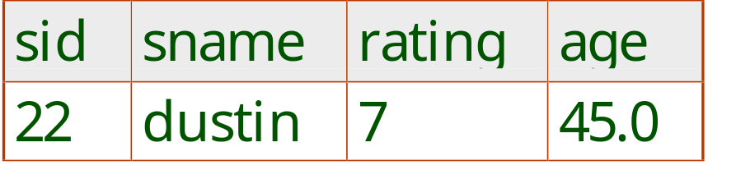


Union, Intersection, Set-Difference
All of these operations take two input relations, which must be union-compatible:
  Same number of fields.
  `Corresponding’ fields have the same type.
What is the schema of result?
Occur in either S1
or S2 or both
Occur in S1
but not in S2
Occur in both S1
and S2
Notes:
9

Slide 12
More Example Instances
Work out on board
S3
sid
sname
rating
age
S
3
∪
S
4
23
sandy
7
21.0
32
windy
8
19.5
S
3
∩
S
4
59
rope
10
18.0
S
3
−
S
4
S4
sid
sname
rating
age
23
sandy
7
21.0
32
windy
8
19.5
45
jib
5
25.0
68
topsail
10
25.0
Notes:
5

Slide 13
Union, Intersection, Set-Difference
(continued)
sid
sname
rating
age
Answers
23
sandy
7
21.0
32
windy
8
19.5
59
rope
10
18.0
45
jib
5
25.0
68
topsail
10
25.0
S
∪
3
S
4
sid
sname
rating
age
sid
sname
rating
age
23
sandy
7
21.5
59
rope
10
18.0
32
windy
8
19.5
S
−
∩
3
S
4
S
3
S
4
Notes:
9

Slide 14
Bag union, intersection, and difference
Card(t,R) means the number of occurrences of tuple t in relation R
Card(t, R∪^{d}S) = Card(t,R) + Card(t,S)
Card(t,R∩^{d}S) = min{Card(t,R), Card(t,S)}
Card(t,R–^{d}S) = max{Card(t,R)–Card(t,S), 0}
Example: R= {A,B,B}, S = {C,A,B,C}
  R ∪^{d} S = {A,A,B,B,B,C,C}
  R ∩^{d} S = {A,B}
  R –^{d} S = {B}
  R ∪S={A,B,C}
Notes:
COMP 451/651
Chapter 1

Slide 15
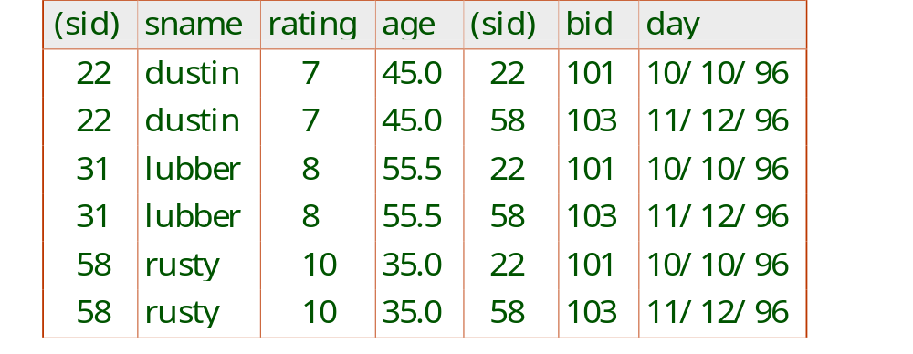
Cross-Product
Each row of S₁ is paired with each row of R₁.
Result schema has one field per field of S₁ and R₁, with field names `inherited’ if possible.
  Conflict: Both S1 and R1 have a field called sid.
Renaming operator:
Notes:
10

Slide 16
Cross Product
R1, R2 cross S1, S2, S3
= (R1, S1), (R1, S2), (R1, S3), (R2, S1), (R2, S2), (R2, S3).

Slide 17

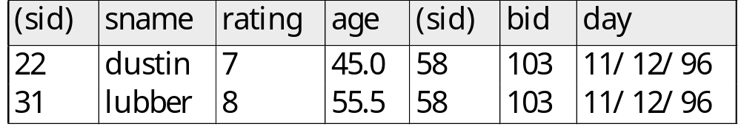
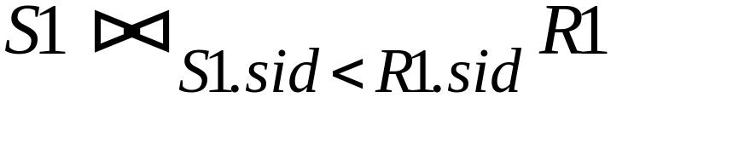
Joins
Condition Join:
Result schema same as that of cross-product.
Sometimes called a theta-join.
Notes:
11

Slide 18
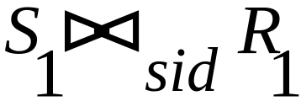
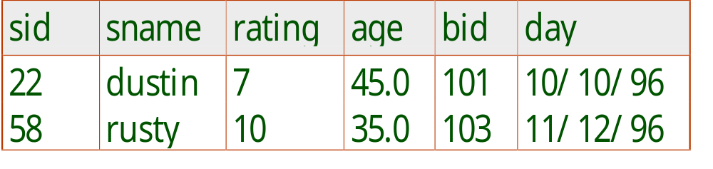
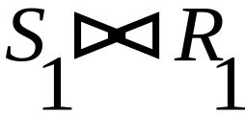
Joins
Equi-Join: A special case of condition join where the condition c contains only equalities.
-looks at name of field
Result schema similar to cross-product, but only one copy of fields for which equality is specified.
Natural Join: Equijoin on all common fields (i.e., fields that have the same name) - denoted as
Notes:
12

Slide 19
Outer joins
°
°
°
R⋈S, R ⋈_{L}S, R ⋈_{R}S (o stands for outer)
called outer join, left outer join, right outer join
It is the similar to R ⋈S. The only difference is that tuples from R and S that do not join with the other tables are also included, where null values are added for the missing data.

Slide 20
example
Student s1 s2 s3
Enrolled s1c1 s2c2 s4c3
Result s4, null, c3

Slide 21

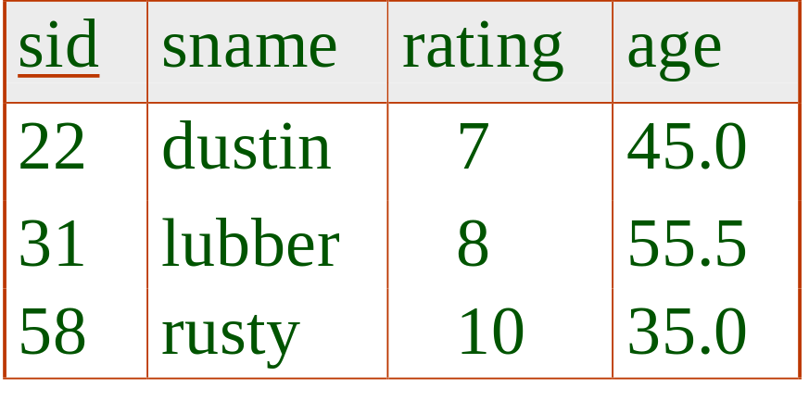
Example
R
S
°
R⋈S = ?
What about left and right outer joins?

Slide 22

Division
Not supported as a primitive operator, but useful for expressing queries like: Find sailors who have reserved all boats.
Let A have 2 fields, x and y; B have only field y:
  A/B contains all x tuples (sailors) such that for every y tuple (boat) in B, there is an xy tuple in A.
In general, x and y can be any lists of fields; y is the list of fields in B, and x y is the list of fields of A.
Notes:
13

Slide 23
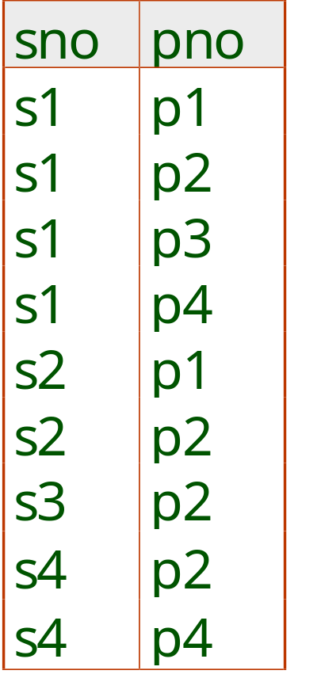
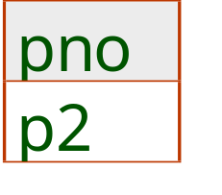
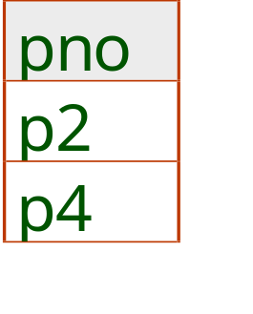
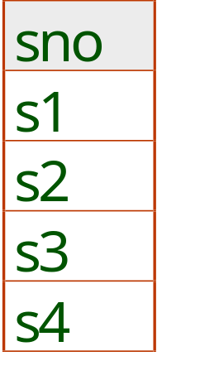
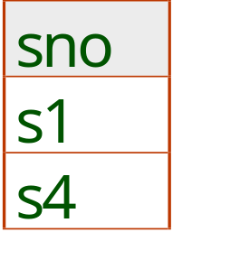
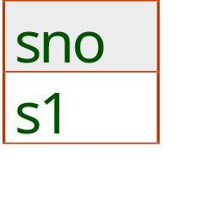
Examples of Division A/B
B1
B2
p1
B3
A
A/B1
A/B2
A/B3
Notes:
14

Slide 24
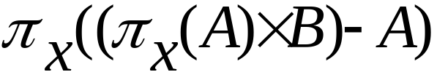
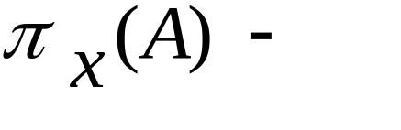
Expressing A/B Using Basic Operators
Division is not essential operation; just a useful shorthand.
  (Also true of joins, but joins are so common that systems implement joins specially.)
Idea: For A/B, compute all x values that are not `disqualified’ by some y value in B.
  x value is disqualified if by attaching y value from B, we obtain an xy tuple that is not in A.
  Disqualified x values:
A/B:
all disqualified tuples
Notes:
15

Slide 25
Expressing A/B Using Basic Operators
(continued)
sno
pno
sno
pno
A/B2
s1
p2
s2
p4
sno
s1
p4
s3
p4
s1
s2
p2
(
π
x B2
) - A
s2
sno
A
s2
p4
s3
sno
s3
p2
s4
s2
s3
p4
π
A
s4
p2
s3
sno
)
π
(
(
π
x B2
) - A
s4
p4
sno
sno
A
π
A
x B2
sno
sno
π
- (
π
(
(
π
x B2
) - A
)) =
s1
sno
A
sno
sno
A
s4
Notes:
15

Slide 26
Expressing A/B Using Basic Operators
(continued)
Work A/B3 on board
Notes:
15

Slide 27
Expressing A/B Using Basic Operators
(continued)
sno
pno
sno
pno
s2
p4
A/B3
s3
p1
s1
p1
sno
s1
p2
s3
p4
s1
s1
p4
s4
p1
s2
s2
p1
s2
p2
(
π
X B3
) - A
sno
A
s3
s2
p4
sno
s4
s3
p1
s3
p2
s2
π
A
s3
p4
sno
s3
s4
p1
s4
π
X B3
s4
p2
) - A
)
A
π
(
(
π
A
X B3
sno
s4
p4
sno
sno
π
- (
π
(
(
π
X B3
) - A
)) =
sno
sno
A
sno
sno
A
s1
Notes:
15

Slide 28

Example Instances
Boats
bid
bname
bcolor
101
Gippy
red
Sailors
103
Fullsail
green
Reserves
Notes:
5

Slide 29
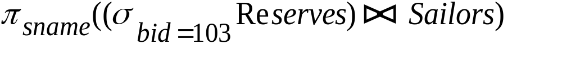
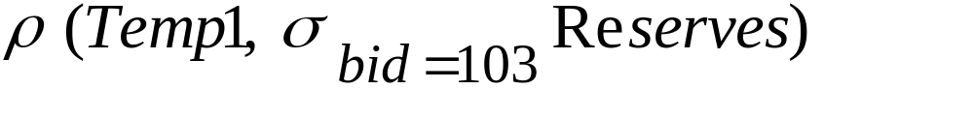
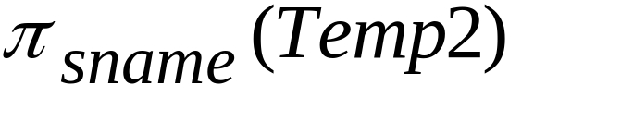
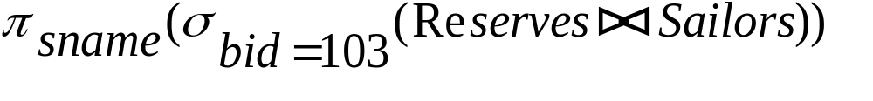
Find names of sailors who’ve reserved boat #103
Solution 1:
Solution 2:
Solution 3:
Notes:
16

Slide 30
Find names of sailors who’ve reserved a red boat
Information about boat color only available in Boats; so need an extra join:
A more efficient solution:
A query optimizer can find this given the first solution!
Notes:
17

Slide 31


Find sailors who’ve reserved a red or a green boat
Can identify all red or green boats, then find sailors who’ve reserved one of these boats:
Can also define Tempboats using union!
  Select boats color=red and union with color=green
What happens if is replaced by in this query?
  Nothing selected because color can’t be red & green
Notes:
18

Slide 32
Find sailors names who’ve reserved a red and a green boat
Previous approach won’t work! Must identify sailors who’ve reserved red boats, sailors who’ve reserved green boats, then find the intersection (note that sid is a key for Sailors):
Notes:
19

Slide 33
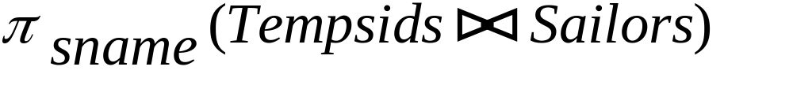
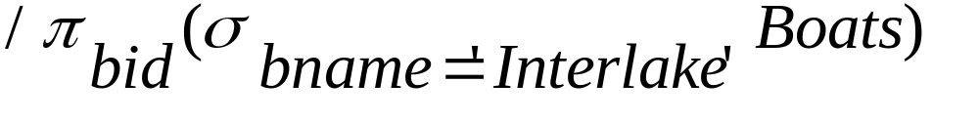
Find the names of sailors who’ve reserved all boats
Uses division; schemas of the input relations to / must be carefully chosen:
To find sailors who’ve reserved all ‘Interlake’ boats:
.....
Notes:
20

Slide 34
Duplicate Elimination
R1 = δ(R2).
R1 consists of one copy of each tuple that appears in R2 one or more times.
R = A B
1 2
3 4
1 2
δ(R) = A B
1 2
3 4
Notes:
COMP 451/651
Chapter 1

Slide 35
Grouping Operator
R1 := γ_{L} (R2). L is a list of elements that are either:
  Individual (grouping ) attributes.
  AGG(A), where AGG is one of the aggregation operators and A is an attribute.
  The most important examples: SUM, AVG, COUNT, MIN, and MAX.
π_{starName,mYear(}σ_{cTitle>=3}
(γstarName,MIN(year)->mYear, count(title)->cTitle(StarsIn)))
Notes:
COMP 451/651
Chapter 1

Slide 36
Applying γ_{L}(R)
Group R according to all the grouping attributes on list L.
  That is, form one group for each distinct list of values for those attributes in R.
Within each group, compute AGG(A) for each aggregation on list L.
Result has grouping attributes and aggregations as attributes.
Notes:
COMP 451/651
Chapter 1

Slide 37
Example: Grouping/Aggregation
R = A B C
1 2 3
4 5 6
1 2 5
γ _{A,B,AVG(C)} (R) = ??
Then, average C within
groups:
A B AVG(C)
1 2 4
4 5 6
First, group R :
A B C
1 2 3
1 2 5
4 5 6
Notes:
COMP 451/651
Chapter 1

Slide 38
Sorting
τ_{A asc, B asc} (R)

Slide 39
Summary
The relational model has rigorously defined query languages that are simple and powerful.
Relational algebra is operational; useful as internal representation for query evaluation plans.
Several ways of expressing a given query; a good query optimizer should choose be able to choose an efficient version.

